Slide 1

Will.Power

Slide 2
Student Success
Carmen Ortiz
Academic Achievement
Advisement Center: Provide holistic advisement and support for students throughout their academic experience
EOF: extensive support program, access and summer academic institute for first-generation, low-income students
Will.Power. Program: Proactive freshman seminar connecting students to their success team, career community and strategies for success
Linda Refsland
Academic Success Services
  Academic Success Center – primary tutoring and skills workshop center
  Academic Foundations – Summer FYF, program, academic mentoring, outreach and support
  Office of Testing – placement, CLEP and local testing for graduate and licensure exams
Will.Power

Slide 3
Success Teams and Career Communities
All students are connected to a group of professionals who are their Success Team:
  Advisor
  Career Coach
  Financial Aid Counselor
Students are also connected to a Career Community that reflects their major choice and career pathways: https://www.wpunj.edu/career-center/career-communities
In addition - students can access a range of support services
  Academic Support Services
    Tutor.com, ASC, Writing Center, SEC, department tutoring
  Accessibility Resource Center
    Works with students who have documented accommodations
  Counseling Health and Wellness
Will.Power

Slide 4
Transition from High School to College
High School
Guidance counselors
Open access to information for parents and family
Teacher and school counselors provide direct support to students and connect students
Frequent, usually daily, feedback from teachers
College
Advisors
FERPA and other expectations limits parent access to information
Students need to self-advocate and utilize resources across campus
Periodic feedback; students need to monitor their own progress
Will.Power

Slide 5
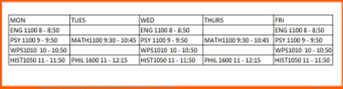
Will. Power. 101
Key components of students’ first year:
  Students take required classes with the same group of students in their Career Community
  Benefit from a schedule with coordinated classes, built-in enrichment activities, and time for jobs and family responsibilities
Sample block schedule for a Psychology major:

Slide 6
FERPA and Modes of Communication
FERPA – students can sign off on access to one or all of the following types of information:
  Financial - critical so families can navigate financial and aid paperwork with WPU
  Academic - Grades
  Judicial - Behavior
Navigate– primary portal for academic alerts, reminders, communication and student support; students can schedule appointments and tutoring
WP Connect – primary student portal to access needed forms, materials and important information
WPU Email – primary official form of communication for the University
  Students must check it frequently and use this when communicating with offices and faculty
  Alternate emails will not be accepted for official responses
Will.Power
Notes:
Family Educational Rights and Privacy Act

Slide 7
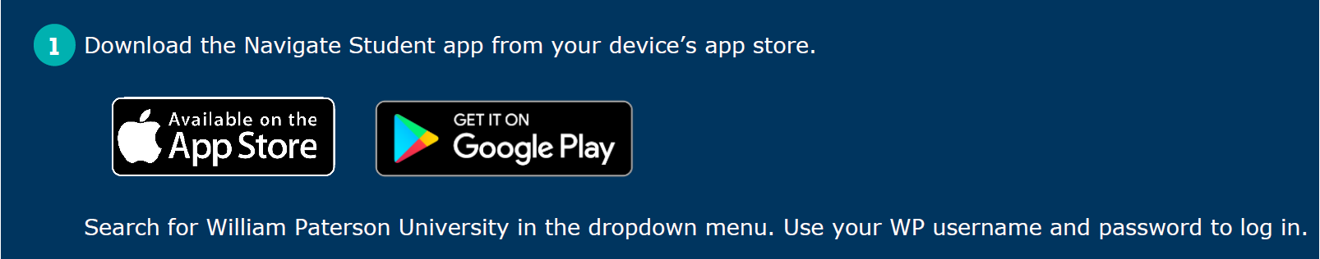
How we communicate concerns to students
Students will get regular outreach and should be checking:
  WP Email, Text Messages, Alerts and information in Navigate
Students will get email reminders about paperwork, outstanding requirements and deadlines; however:
  Their class syllabi and Blackboard course pages are also standard communication method by faculty
Many faculty use our early alert system or will communicate concerns to students, however:
  Faculty also use grades as a way of communicating
  Missing grades should be followed up on by students
  Students are expected to reach out or reply to outreach if they are having difficulties or questions

Slide 8
How Families Communicate Expectations
Family/Guardian
Finances – tuition, books, food, travel, extras, work expectation, who is managing tuition and billing?
Academics – what are you expecting to see?
Work and Family responsibilities – how to schedule?
Students
Finances – how much support is family providing?
Academics – major, what are “good grades”
Privacy – what is private? Academics, relationships, participation in activities?

Slide 9
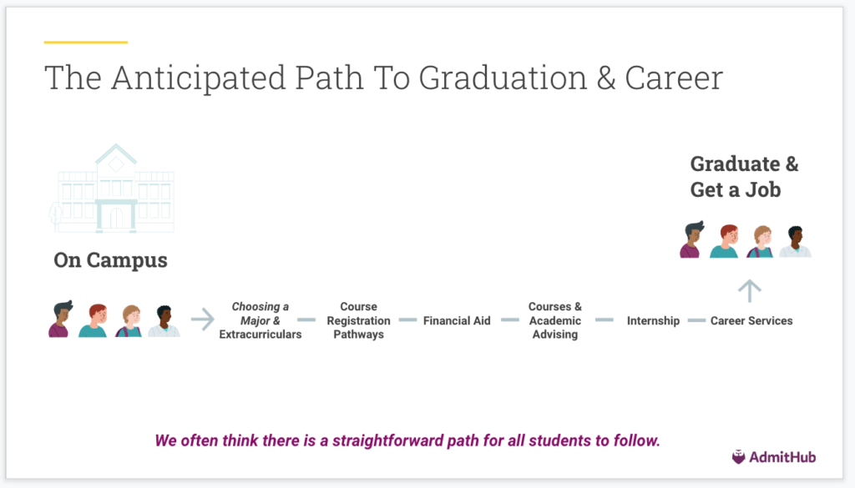
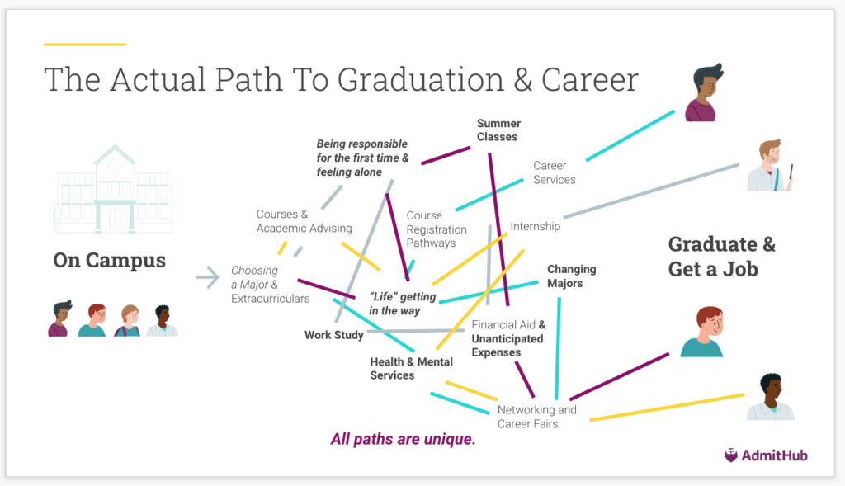
Earning a Degree

Slide 10
Degree Requirements
Components of a Liberal Arts Degree:
  Minimum of 120 credits
  University Requirements
  Core Curriculum – will include subjects across a broad range of areas outside of a student’s major
  Major Requirements
  Minor Requirements, Second Major, or Electives
Pre – Packaging
  All freshmen have their schedule built to meet first semester requirements
  Constructed with time for tutoring, meeting with faculty, engaging with the University community
Will.Power
Notes:
Family Educational Rights and Privacy Act

Slide 11

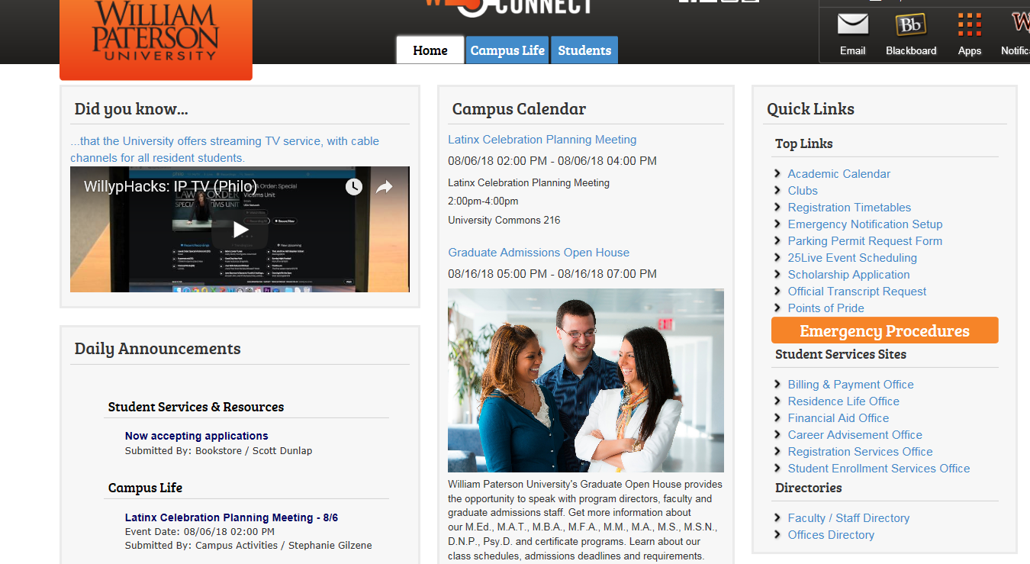
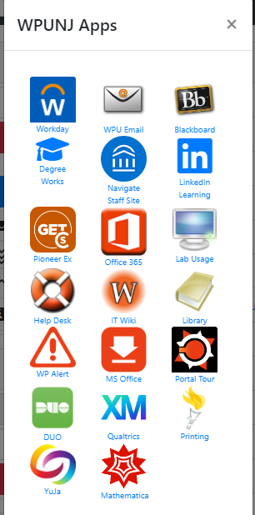
WP Connect

Slide 12
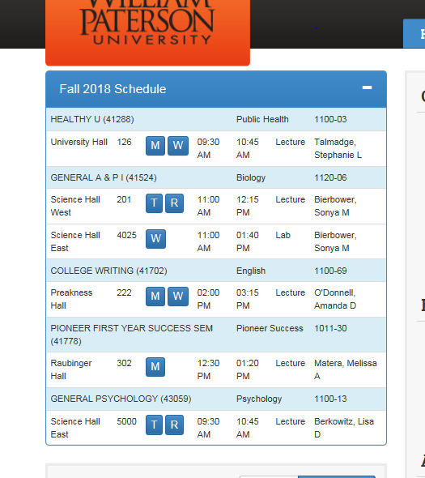
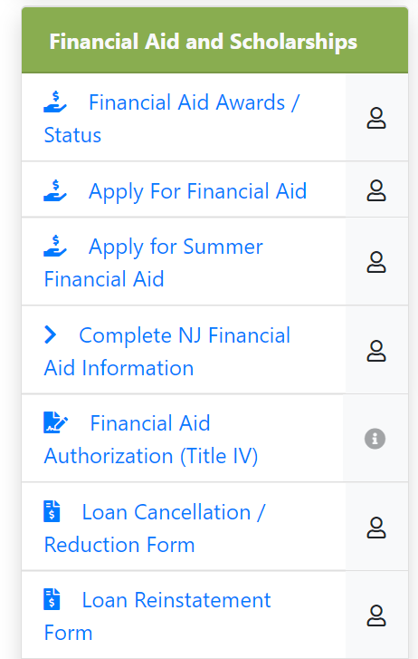
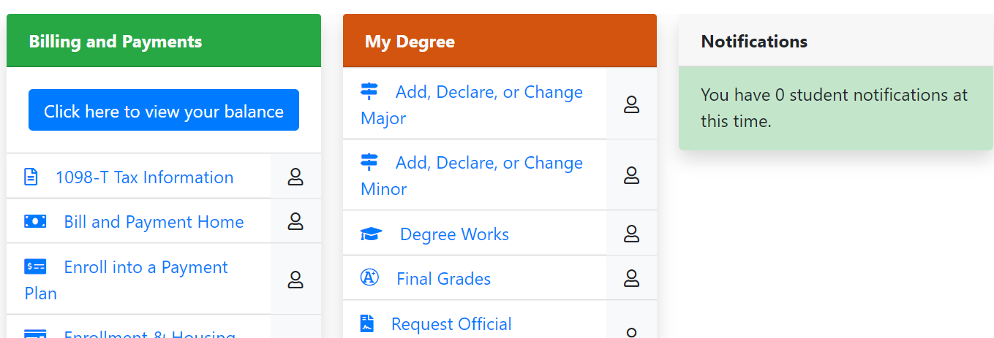

Slide 13
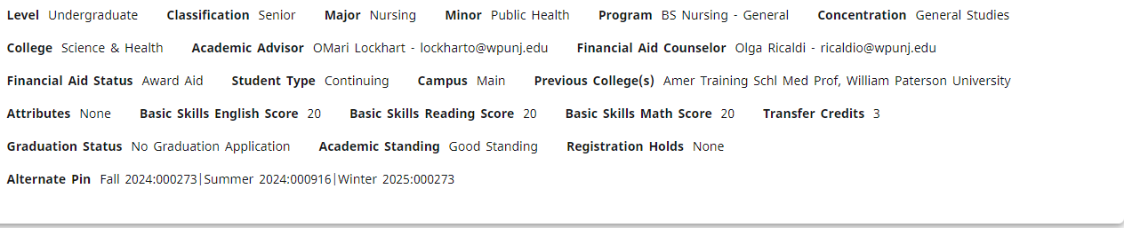
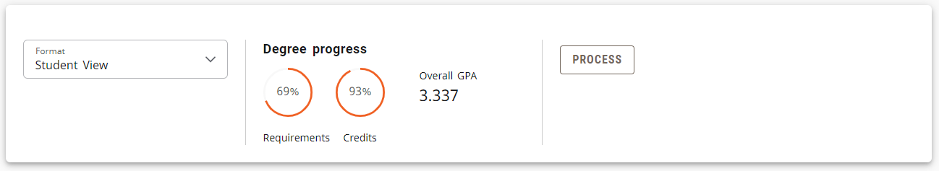
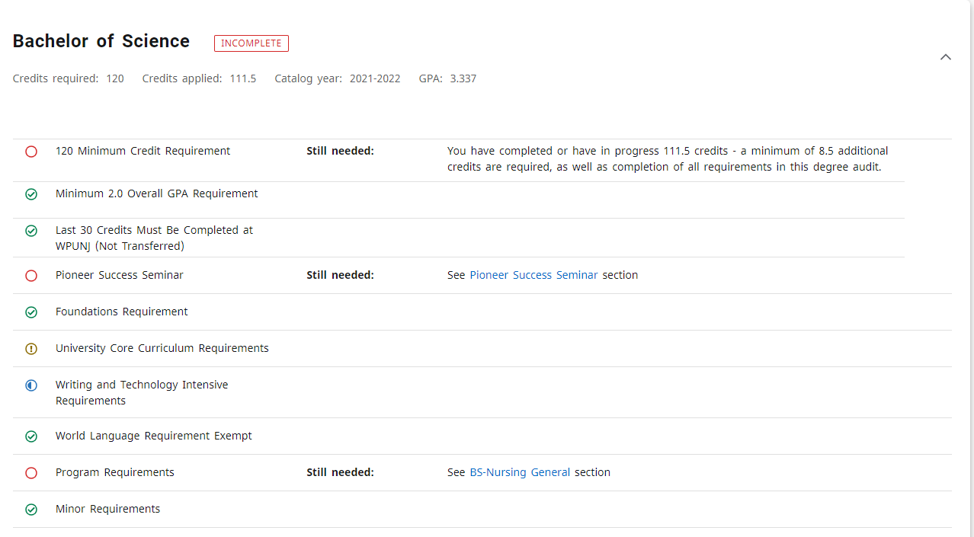

Slide 14
Important Dates and Upcoming Requirements
Transcripts and Score reports
  Final graduation transcript, dual enrollment college transcripts, and/or score reports should be submitted ASAP
Financial Aid Verification Documents
  Emailed notifications have gone out; submit as soon as possible
Health Insurance Waiver
  Waivers are due in September otherwise families will be billed for health insurance – check email
Tuition
  Billing statements are posted in Billing and Payments under Student tab
Immunization Paperwork
  Students must enter their immunization history into their student health portal
Alcohol Education program
  Online program – check email for link
SPARC Violence Prevention program
  Online program – access through Blackboard – check email
* Freshman checklist is on WP Connect and will post reminders for many of these items
Will.Power
Notes:
Family Educational Rights and Privacy Act

Slide 15
Key Contact Information
Carmen Ortiz – OrtizC@wpunj.edu
Linda Refsland – RefslandL@wpunj.edu
Advisement - AskTheAdvisor@wpunj.edu
Registrar’s Office – Registrar@wpunj.edu
Student Enrollment Services - StudentServices@wpunj.edu
Financial Aid – FINAID@wpunj.edu
Counseling Health and Wellness – WPUImmunization@wpunj.edu
Parent and Family Relations – WPFamilies@wpunj.edu
Will.Power
Notes:
Family Educational Rights and Privacy Act

